Slide 1
GNOME2 Microprocessor
write
8
data
CU
rd_data
IR
4
8
4
1
abus
bbus
15
addr
0
jump_pc
C
alu_op
7
ALU
1
Z
PC
0
+1
ACC
Notes:
This is the GNOME2 block diagram. Registers include the four bit ACC, eight bit IR, seven bit PC, the C and Z flag bits, and the current state register inside the control unit. IR is the instruction register, ACC is the accumulator, and PC is the program counter. The rest of the logic is combinational and includes the addr and PC multiplexors, control unit next state logic, PC incrementer, and the arithmetic and logic unit (ALU). The data bus (dbus) is bidirectional and is driven by GNOME2 when the write signal is asserted. When write is not asserted, GNOME2 may assert output enable (not shown) to enable external ram, rom, or I/O to drive the data bus.
This block diagram did not just appear out of thin air. It is a fairly typical example of an accumulator based architecture and is normally obtained after careful study of the proposed instruction set and several iterations. A course in computer organization typically spends a fair amount of time developing block diagrams like this and comparing various alternative designs.

Slide 2
Gnome2 control unit
Simple state machine
Fetch/Decode/Execute states
Each state takes one clock cycle
A complete loop is an instruction cycle
Dcd
Fetch
Exec
Notes:
Each state lasts for one clock cycle. During the fetch state the current instruction is fetched from code memory and loaded into the instruction register. During the decode state the instruction is decoded and any required operands are fetched from memory. During this state the address bus may be driven by an operand address. The operand address is generated from the least significant nibble of the instruction byte in IR. During the execute state the instruction is executed. A nibble may be stored in data memory or the accumulator updated. All three states constitute what is often called an instruction cycle.
A processor designer is interested in reducing the number of states and in how fast the state machine can be clocked since both determine the speed of the processor. It’s no good to have a very high clock rate if it takes a large number of states per instruction.
Questions:
1. Draw a timing diagram showing a clock, the current state, and next state for at least two instruction cycles.
2. Describe what needs to be done to implement the state machine controller in hardware.

Slide 3
Fetch cycle step 1: addr <= PC
write
8
data
CU
rd_data
IR
4
8
4
1
abus
bbus
15
addr
0
jump_pc
C
alu_op
7
ALU
1
Z
PC
0
+1
ACC
Notes:
When the CU state machine is in the fetch state, the address bus (addr) is driven with the contents of the PC. Since the PC is only 7 bits wide and the address bus is 15 bits, an additional 8 bits of ‘0’ is used to pad out the address. The address bus is 15 bits wide to accommodate a 32k byte SRAM chip for external memory. In fact a variety of schemes could be used to derive the address from the PC. The main idea is that the PC is used to generate the memory address during the fetch cycle.
Questions:
1. What is the range of code addresses?
2. How many data addresses are there?
3. What is the range of memory addresses in hexadecimal?
4. What control signal is used to determine whether addr is driven with the contents of PC or the abus?
5. What value would need to be concatenated to the abus in order to put all data addresses at the top of memory?

Slide 4
Fetch cycle step 2: IR<= data
write
8
data
CU
ram
IR
rd_data
4
8
4
1
abus
bbus
15
addr
0
jump_pc
C
alu_op
7
ALU
1
Z
PC
0
+1
ACC
Notes:
After tacc (ram access time) memory drives the data bus with the instruction at location addr. Sometimes this is abbreviated as IR= C(addr). Note that the data is simply made available at the input of IR. Since IR is just 8 edge triggered D flip flops we can call the input ir_d (ir under d). No latching of the data occurs until the next rising edge of the clock. The rising edge of the clock terminates the fetch cycle and begins the decode cycle.
Question:
A D-FF will latch its input whenever a rising clock edge occurs. We only want IR to latch the data bus at the end of the fetch cycle and not during the other two states. How can we cause IR to change at the end of the decode cycle and keep it the same during the other two cycles? This is an important technique which we’ll want to use on all the other machine registers.

Slide 5
Fetch cycle: PC<= PC+1
write
8
data
CU
rd_data
IR
4
8
4
1
abus
bbus
15
addr
0
jump_pc
C
alu_op
7
ALU
1
Z
PC
0
+1
ACC
Notes:
While the next instruction is being fetched, the path through the PC incrementer and PC multiplexor is enabled so that the PC will get incremented at the end of the fetch cycle. Note that like the IR register, PC+1 is only presented to the input of the PC flip flops and is not latched until the next rising clock edge.
PC is essentially a 7 bit binary counter that can be loaded in parallel from the seven bit abus driven by IR. The PC counter is synchronous and thus only changes on rising clock edges. If jump_pc is asserted the counter is loaded with a new value. This occurs during the execute cycle of a jmp instruction. If jump_pc is not asserted the output of the incrementer logic is latched instead. Does this mean that the PC is incremented 3 times per instruction cycle? No! There’s actually a hidden control signal which causes the current value in the PC to be latched. The PC multiplexor is thus a 3 to 1 mux but only two inputs are shown here for clarity. The same thing is true for other registers. If the register is to stay the same then it is simply loaded with its current value. Thus all registers are clocked on every rising clock edge. This is called a fully synchronous design which is the preferred technique for modern ASICs (application specific integrated circuits) and other digital chips.

Slide 6
Decode cycle:
Decode current instruction in IR
write
8
data
CU
rd_data
IR
4
8
4
1
abus
bbus
15
addr
0
jump_pc
C
alu_op
7
ALU
1
Z
PC
0
+1
ACC
Notes:
The rising clock edge which causes the CU state machine to transition from the fetch state to the decode state also latches the new instruction present on the data bus into the instruction register (IR). The instruction decode logic responds to the changes in the instruction register by asserting and deasserting various control signals such as rd_data and alu_op. The operations which occur are dependent on the current instruction in IR and can include fetching an operand from data memory. We will look at some of these in the next few slides. First let’s look at the instruction set for GNOME2.

Slide 7
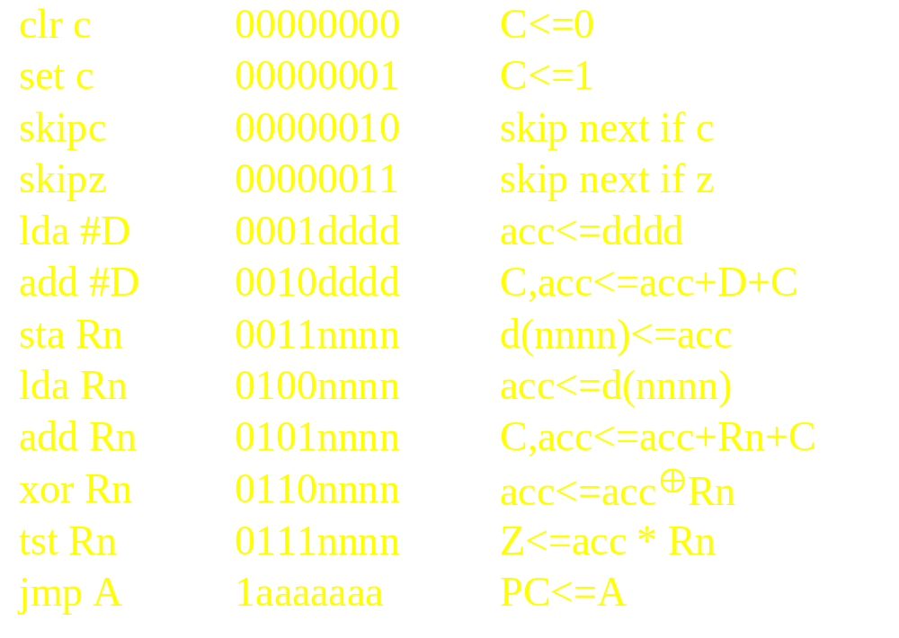
GNOME2 Instructions
Notes:
GNOME2 has a primary 4 bit opcode. Opcode 0 is reserved for the micro instructions of which there are four. The least significant 2 bits are used to encode four micro instructions. These four imply the Z, C, or PC as operands and are thus called implied address instructions. Opcodes 1 and 2 are used for load and add immediate instructions. The other four bits of the instruction are used as an immediate operand so these are called immediate mode instructions. Opcodes 3, 4, 5, 6, and 7 are all direct address instructions since the other four bits of the instruction are the address of the operand. These four bits are concatenated with all 1’s to form an address in the range 0x7ff0 to 0x7fff and are used to fetch or store an operand in external ram. This is sometimes called data memory as contrasted with code memory which for GNOME2 is in the range of 0x0000 to 0x007f. Only the least significant nibble of data memory is used. The last instruction uses up 8 opcodes to allow a 7 bit jump address.

Slide 8
Decode cycle: direct address
Lda 5
write
D(5)
8
data
CU
ram
IR
rd_data
4
8
4
1
abus
bbus
5
15
addr
0
jump_pc
C
alu_op
7
ALU
1
Z
PC
0
+1
ACC
Notes:
Here we examine the operations during the decode cycle while the instruction register contains an lda 5. This instruction is encoded as B”0100_0101” or 0x45. The ‘5’ is combined with a vector of all 1’s and used to drive the address bus with the address 0x7ff5. We call this location 5 in data memory even though it’s really just in the top 16 bytes of a 32k SRAM. The contents of location 5 in data memory, D(5), or the contents of 0x7ff5 if you prefer, are driven onto the data bus by the external SRAM. The internal control signal write is turned off so GNOME2 is not driving the bus. Problems would occur if more than one driver was turned on at a time! D(5) on data bus is available at the input of IR as usual and at the end of the decode cycle is latched in IR. What happens to the opcode 4 in IR? Nothing. The fact that there was a 4 in the opcode portion of IR is what set things in motion and caused rd_data to be asserted. It also causes oe_n, another external ram control signal, to be asserted. This signal isn’t shown but it is what enables the external ram’s bus drivers. The opcode also enables a slightly different control signal from that asserted during instruction fetch. During the instruction fetch cycle the entire IR is loaded from the data bus. During a load direct (fetch operand) only the least significant four bits are loaded. This signal is called ld_ir_lsn but it isn’t shown here either. We’ll look at a few of these details later. First let’s take a look at the execute cycle operations.

Slide 9
Execute cycle:
LDA 5
write
8
data
CU
rd_data
IR
4
8
4
1
abus
bbus
15
addr
0
jump_pc
C
alu_op
7
ALU
Passa_f
1
Z
PC
0
+1
ACC
Notes:
Recall that for LDA 5, the direct mode address (5) is used to fetch the contents of data ram at location 5 (0x7ff5) which then replaces the 5 in the IR at the end of the decode cycle. During the execute cycle, the operand which was fetched is now available on the abus since that is driven by IR(4:7). All that is needed is for the ALU to be set up to pass abus through to the ACC. At the end of the execute cycle the next rising edge clocks the new value into ACC.
All other arithmetic instructions are similar. An add instruction would simply set up the ALU for addition and at the end of the cycle, ACC would be loaded with the sum of abus, bbus, and C.
By now you may have noticed that the registered ALU is similar to the one you may have designed in Comp Eng 112. The PC and its associated multiplexor and incrementer are a simpler version of registered ALU. The IR and its multiplexor is even simpler as is the address bus mux. All these make up what is normally called the data path portion of GNOME2. The control unit and associated instruction decoder is what makes GNOME2 more interesting than a collection of logic and flip flops.
Lets finish up the execute cycle with a discussion of the operation during a jmp instruction.

Slide 10
Execute cycle:
Jmp loop
write
8
data
CU
rd_data
IR
4
8
4
1
abus
bbus
15
addr
0
jump_pc
C
alu_op
7
ALU
1
Z
PC
0
+1
ACC
Notes:
For a jump instruction, the destination address is implied to be the PC and the source address is implied to be the address portion of IR, IR(1:7). The control signal jump_pc is asserted to connect the address to the input of PC. At the end of the execute cycle the new address is latched thus overwriting the next sequential address which was in the PC since the end of the last fetch cycle.
GNOME is now ready to begin another fetch cycle to fetch the instruction stored at location loop.
That’s about all there is to it. Bigger processors just increase the sizes of everything, do more things in parallel, sometimes attempt to work on more than one instruction at a time, and other tricks to speed things up. A few go the other direction. For example, GNOME2 is a four bit processor but instructions are 8 bits wide. It would be useful for everything to be a uniform four bits. So called four bit processors (you are probably wearing one on your arm now) use more than one four bit nibble to make up an instruction. This is also typical of larger processors including the ubiquitous pentium. Instructions are made up of one or more bytes and are read in chunks of four or more bytes at a time. There are enough complications to warrant three or more additional courses on this topic of computer organization but this is enough for now!

Slide 11
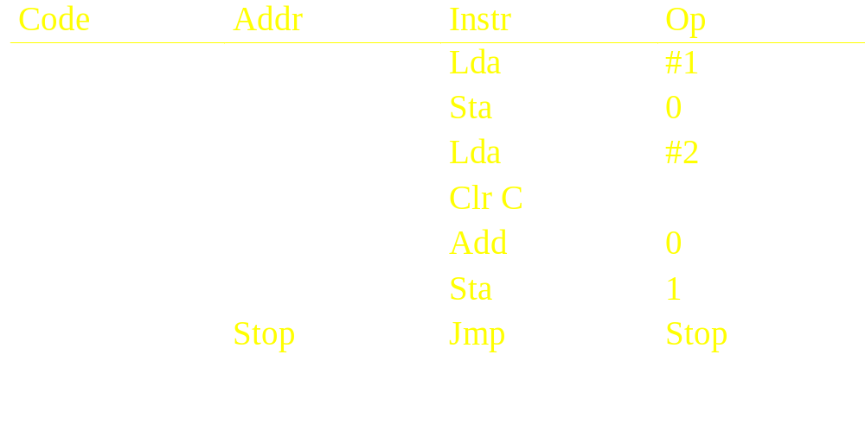
Calculate 2+1
Notes:
This is a simple program to add 1 plus 2. Register 0 is loaded with a ‘1’, then the accumulator is loaded with a 2, added to register 0 and the result stored in register 1. We would express this in C as sum=1+2 where sum is assigned to location 1. Note the use of a ‘branch to self’ to bring the program to a halt since Gnome has no halt instruction.
Assignment:
1. Write down the machine code corresponding to these instructions.
2. What determines the value of ‘stop’ and thus the code for the jmp instruction?
3. How long does it take to execute this program in machine cycles?

Slide 12
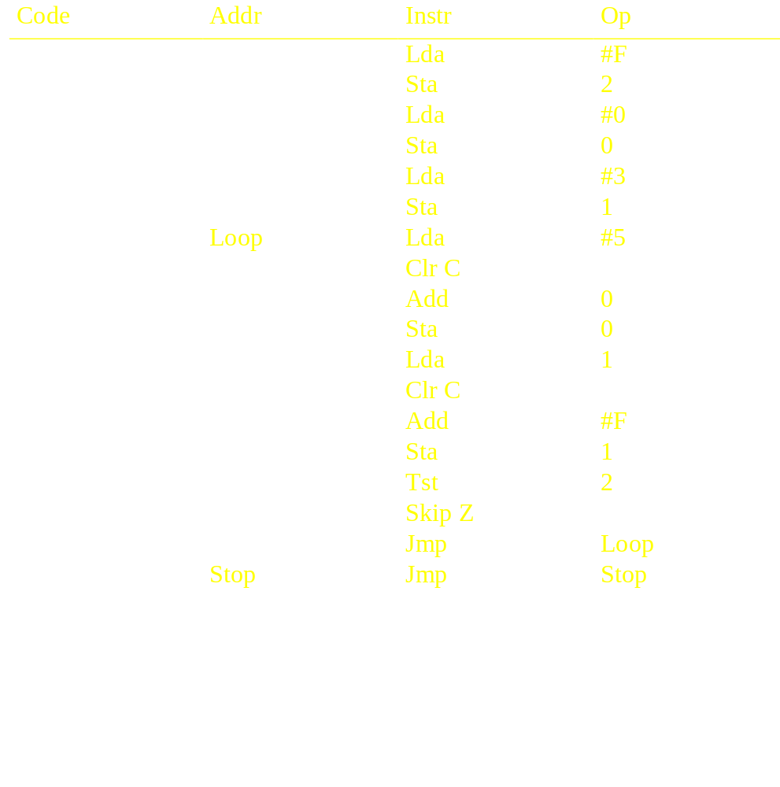
Calculate 3*5 with for loop
Notes:
Here is a simple program which implements a for loop to multiply 5 times 3 by adding 5 to itself 3 times. Data location 0 is used to hold the product and location 1 is used to hold the loop counter. Note the addition of -1 since Gnome has no subtract instruction. Also note the use of the skip if zero instruction to implement the end of loop test. Gnome has no conditional branch as such.
Assignment:
1. Write down the machine code for this program.
2. How long does it take to execute this program in machine cycles?
3. Discuss how you would modify Gnome to:
a) implement bit addressable ram
b) simple parallel port (4-bit) I/O.
c) a subroutine call.

